Slide 1
Group: KIRA
Skin Cancer Classification

Slide 2
INDEX
No. | Topics
1. | Problem Statement
2. | System Overview
3. | Dataset and Prediction Model
4. | Technologies Used
5. | Skin Disorder
6. | Future Scope
7. | References

Slide 3
Problem Statement
Skin Cancer Detector
Theme by Virtusa Technologies
We rely on your expertise to help doctors and surgeons to identify the associated allergies from capture images of skin, predict the probability of skin cancer, and suggest remedies to prevent further damage. Enabling smart features like connecting with forums offering discussions around the problem or prescribing a skin specialist based on a geographic location will give extra advantages to your solutions!

Slide 4
2. System Overview
According to the given problem statement, we have build an online tool that can tell users (doctors and lab technologists) the highest probability diagnoses for a given Skin Lesion and Skin Cancer. Users can submit an image of a skin lesion and get an immediate diagnosis of the skin disorder. The tool will provide information and Q&N of further debilitation. It will display the details and contact information of the nearest clinics. The website provides a comprehensive list of post-cancer practices, supported by Integrative Medicine experts. The Doctor assistance is applied to resolve the queries and issues related to skin disorders and treatment.

Slide 5
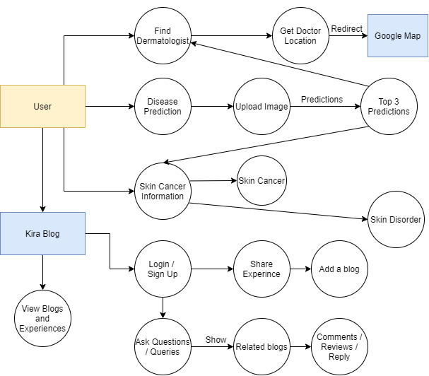
2.a System
Diagrams
DFD Level: 2

Slide 6
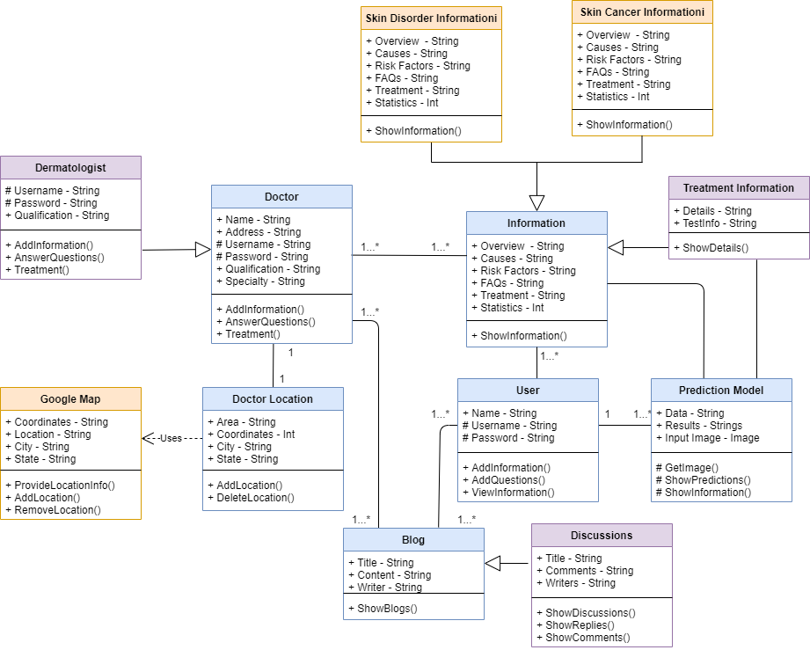
Class Diagram

Slide 7
2.b How Model Works
The following steps are used for the classification of the images:
Initialization of all images and the parameters that are needed for the model.
Take all the input training images and save them into the system.
Generate the Convolutional Neural Network for the classification of the images.
Use the Convolutional Neural Network for training.
Save the model into the system for the classification of the test data.
Evaluation of the model on the test data. The metrics used are accuracy, precision, recall, and F1 score.

Slide 8
CNNs are neural networks with specific architecture that are used for image recognition and classification.
CNN learns the relationship between the input objects and the class labels and comprises two components: the hidden layers in which the features are extracted and, at the end of the processing, the fully connected layers that are used for the actual classification task.
It can directly learn the relationship between the raw pixel data and the class labels through end-to-end learning.
Each node connects only to some nodes in the next layer. This key feature can successfully capture the spatial and temporal dependencies in an image through the application of relevant filters.

Slide 9
In the Convolutional Neural Network, the following three types of layers are used:
Convolution Layer
Pooling Layer
Fully Connected Layer
Combining convolutional and pooling layers, CNN can combine local features and learn more global features of the image.
Dropout is a regularization method, where a proportion of nodes in the layer are randomly ignored for each training sample. It improves generalization and reduces overfitting.
The relu rectifier activation function is used to add non-linearity to the network.
The Flatten layer is used to convert the final feature maps into one single 1D vector.

Slide 10
2.c Blogs
KIRA-Blogs, a Blogging website for information about skin cancer, consists of following features -
User can read blogs related to various skin diseases.
User can sort available blogs according to Ratings and Reviews .
Users need to Log-in in order to write a review or add a blog.
Sign up feature is provided for new users.
Users can interact with the blogger in the review section.

Slide 11
3. Dataset
Link: https://www.kaggle.com/kmader/skin-cancer-mnist-ham10000 [License: CC BY-NC-SA 4.0]
The final dataset consists of 10015 dermatoscopic images which can serve as a training set for academic machine learning purposes. Cases include a representative collection of all important diagnostic categories in the realm of pigmented lesions:
Actinic keratoses and intraepithelial carcinoma / Bowen's disease (akiec),
basal cell carcinoma (bcc) - Skin Cancer
benign keratosis-like lesions (solar lentigines / seborrheic keratoses and lichen-planus like keratosis, bkl)
dermatofibroma (df)
melanoma (mel) - Skin Cancer
melanocytic nevi (nv)
vascular lesions (angiomas, angiokeratomas, pyogenic granulomas and hemorrhage, vasc).

Slide 12
3.a Prediction Model
Basic Deep Learning model based on python is trained, tested and hypertuned for best and optimal results so that model can work in computationally weak devices like mobile and browsers.
Deep Learning model has been converted with tensorflow.js convertors API to model.json and some shared .bin files which will be use to serve model in browsers.
Tensorflow.Js has been used in frontend to load the model asynchronously.
Then Frontend serves the Image to be predicted to model where it is resized to fullfill requirements of model.
Model then calculates the prediction for all different 7 classes out of which 3 most probable classes are show to user with frontend.

Slide 13
4. Technologies Used
Get Tested:
Deep Learning (CNN etc.)
Tensorflow Js
Find dermatologist: Mapbox API
Blog: HTML, CSS, Bootstrap, Cloudinary(to save images), Node.js, Express.ejs, MongoDB(For Database Management)

Slide 14
5. Skin Disorders
Website is proving following information related to skin-disorder:
Overview
Sample Images
Symptoms
Riskfactor
Treatment
Prevention
Diagnosis
Informations of 17 Skin disorders given to spread awareness among people.Dataset is consist of only 7 disorders, So, our model is capable of predicting probability of those skin disorders

Slide 15
6. Future Scope and Work
Some Future Steps:
Creating Dataset of most of skin disorders.
Saving Predictions of diseases with patient profile.
Doctor Profile and Online appointment booking system.
Connecting testing labs and Medical stores to the system.
Including chat bot for any query.
Direct messaging system to Doctor (User - Doctor communication)
IOS platform application

Slide 16
7. References
We took references for information related to skin cancer and other skin disorder, we used kaggle dataset, and udemy course for blogs
Kaggle Dataset: https://www.kaggle.com/kmader/skin-cancer-mnist-ham10000
Information related skin disorder: https://www.healthline.com/health/skin-disorders
Blogs section of website: https://www.udemy.com/course/the-web-developer-bootcamp/
Motivation: https://www.skincancer.org/
Note: Dataset created in website are taken from different websites, it might be false

Slide 17
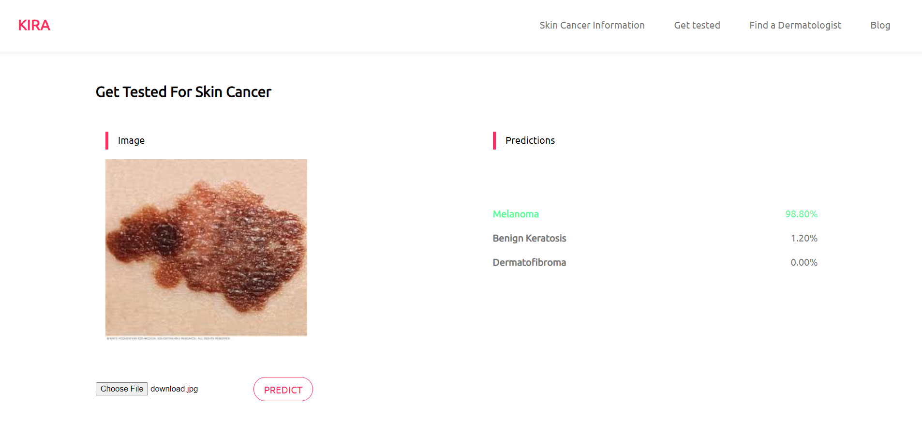
Page: Get Tested
# User can upload Image are click on predict button to identify skin disorder type
# Model will predict probability of top three prediction with decreasing probability of cancer type

Slide 18
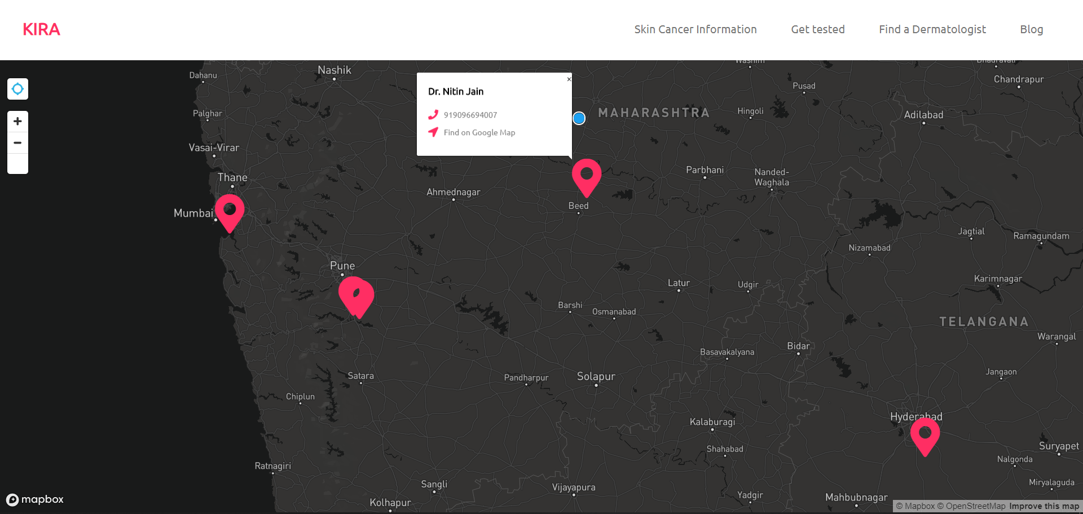
Page: Find a Dermatologist
# Here Blue-dot is user’s locations and, Others are location of Dermatologist near User Location.
# Card of doctor will redirect to google maps to provide directions and reviews.

Slide 19
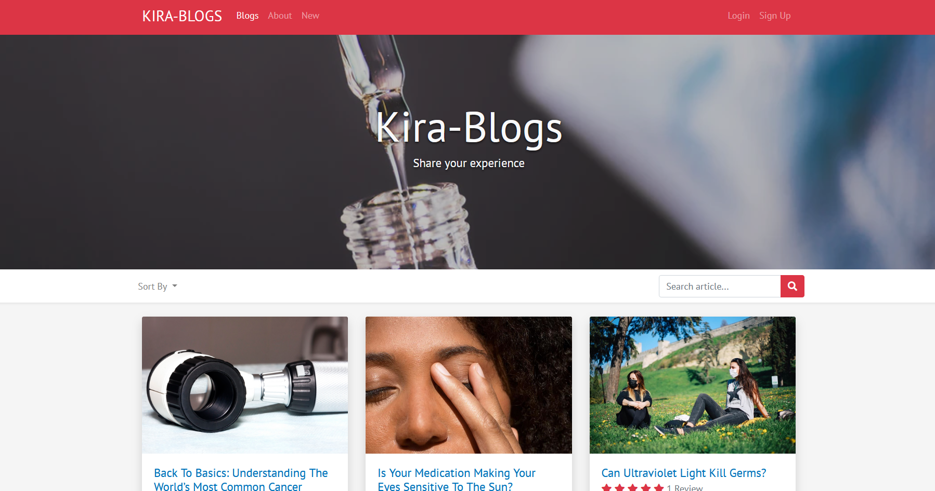
Page: Blog
#User can view blogs without login
#After Login, User can Ask questions, submit reviews as well as share their experiences with other
#Doctor can reply users query with sufficient information

Slide 20
Thank You

